Slide 1


MUSIC
RECOMMENDATION
SYSTEMS
PUJIT GOLCHHA
SHRISTI JAIN
ANANYA KAMDAR
PHALGUNI KOTHARI

Slide 2
INTRODUCTION
Music is an integral part of daily life whether we are traveling, studying, working or even just relaxing.
Online music streaming has become the dominant medium for people to listen to their favorite songs now.
Music streaming services are now able to collect large amounts of data on the listening habits of their customers, which they are using to provide customized recommendations to their listeners.

Slide 3


DATA
Data of 4000 user playlists was obtained from Spotify through their RecSys challenge.
Additional data about features of the songs was scraped from Spotify’s API.

Slide 4
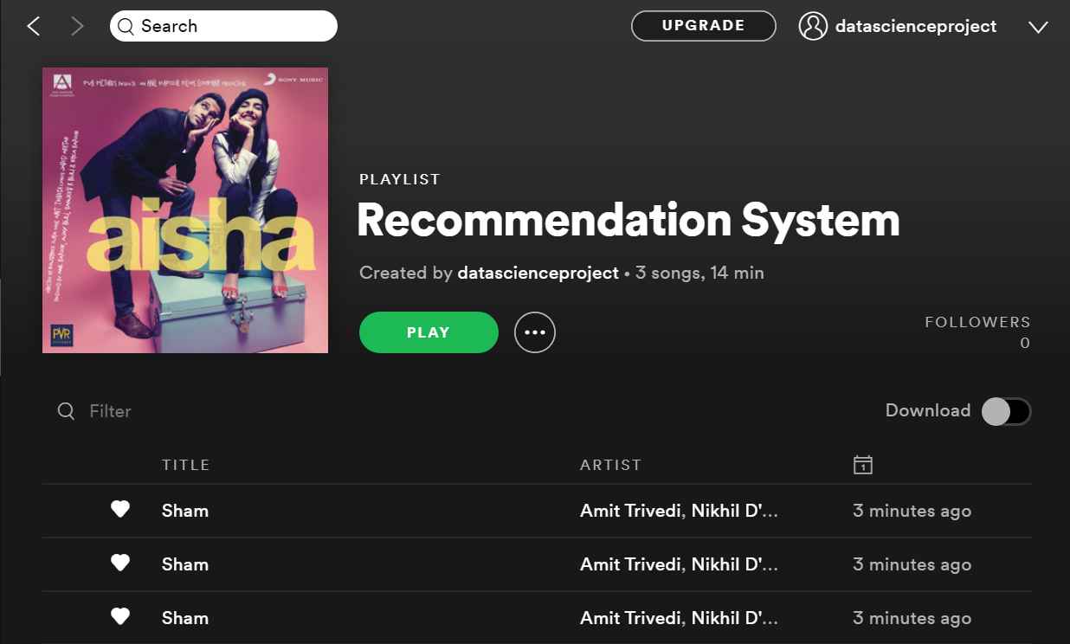







datascienceproject
datascienceproject
datascienceproject

Slide 5


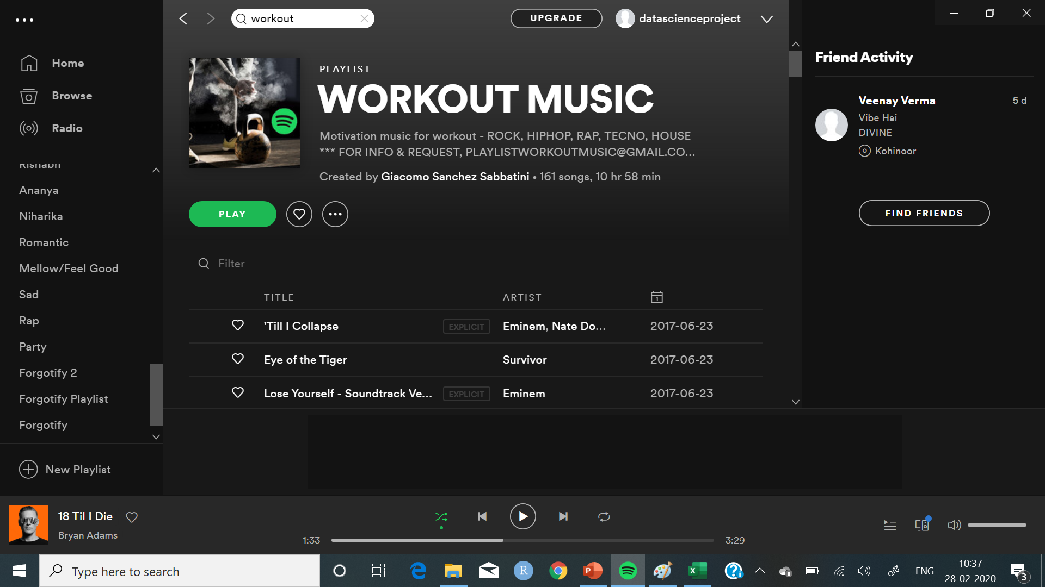
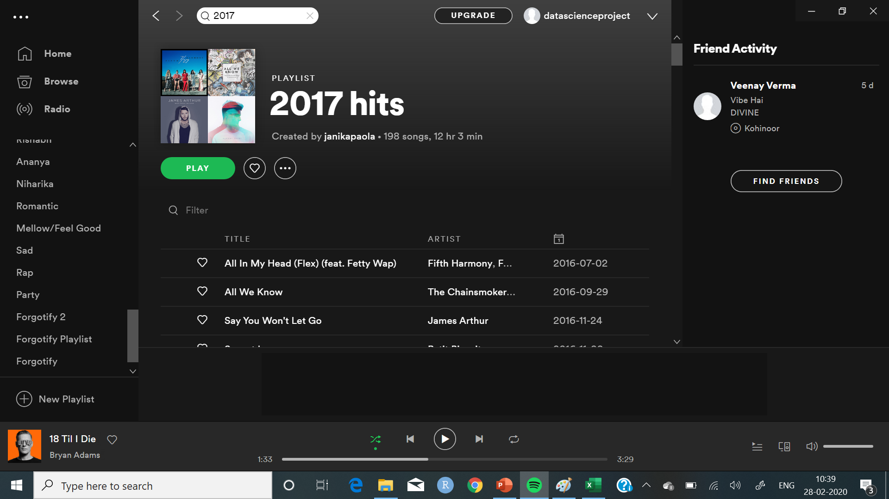

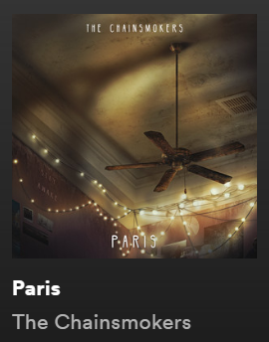

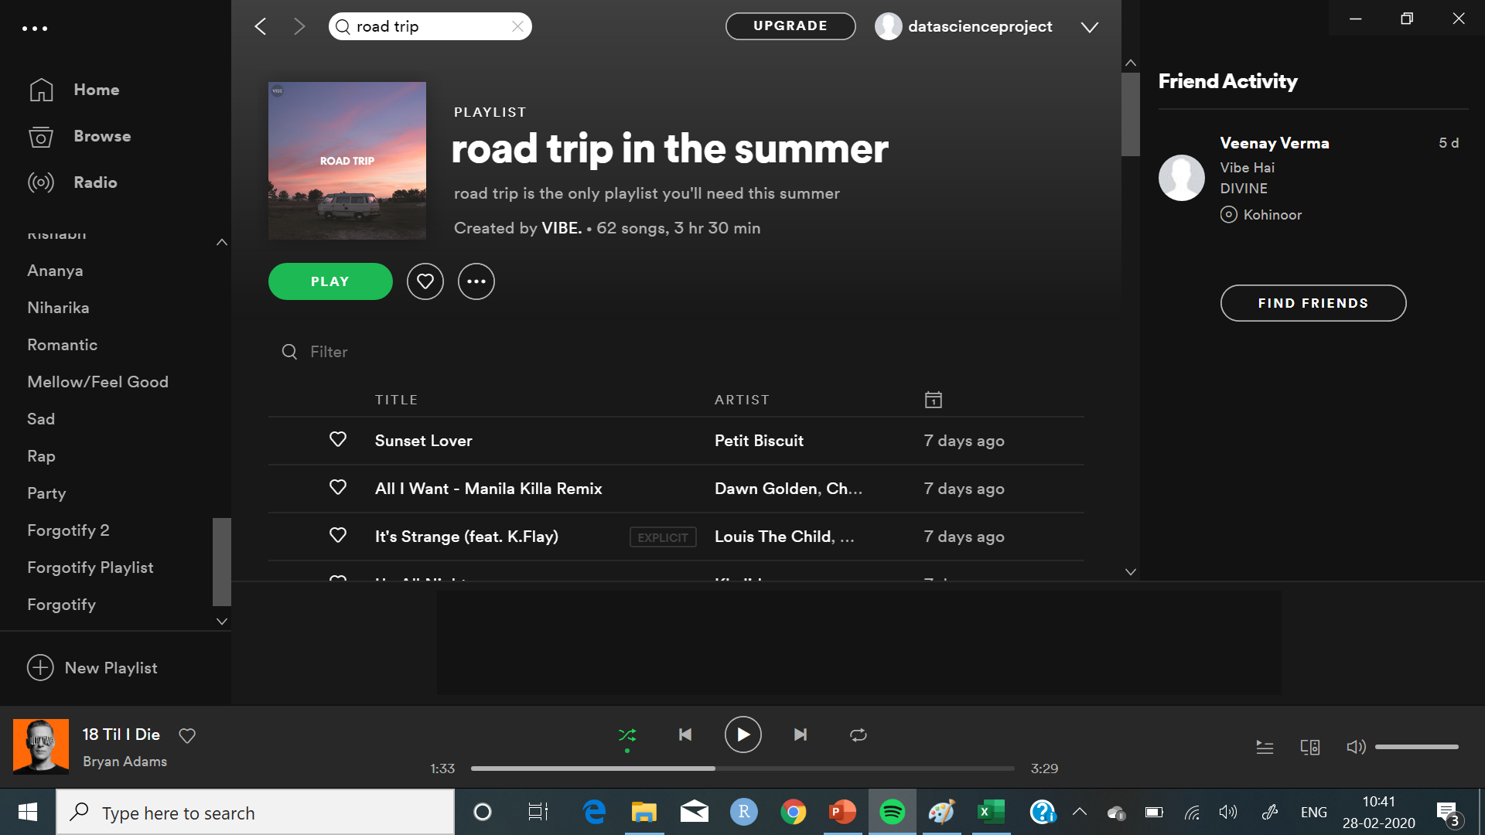
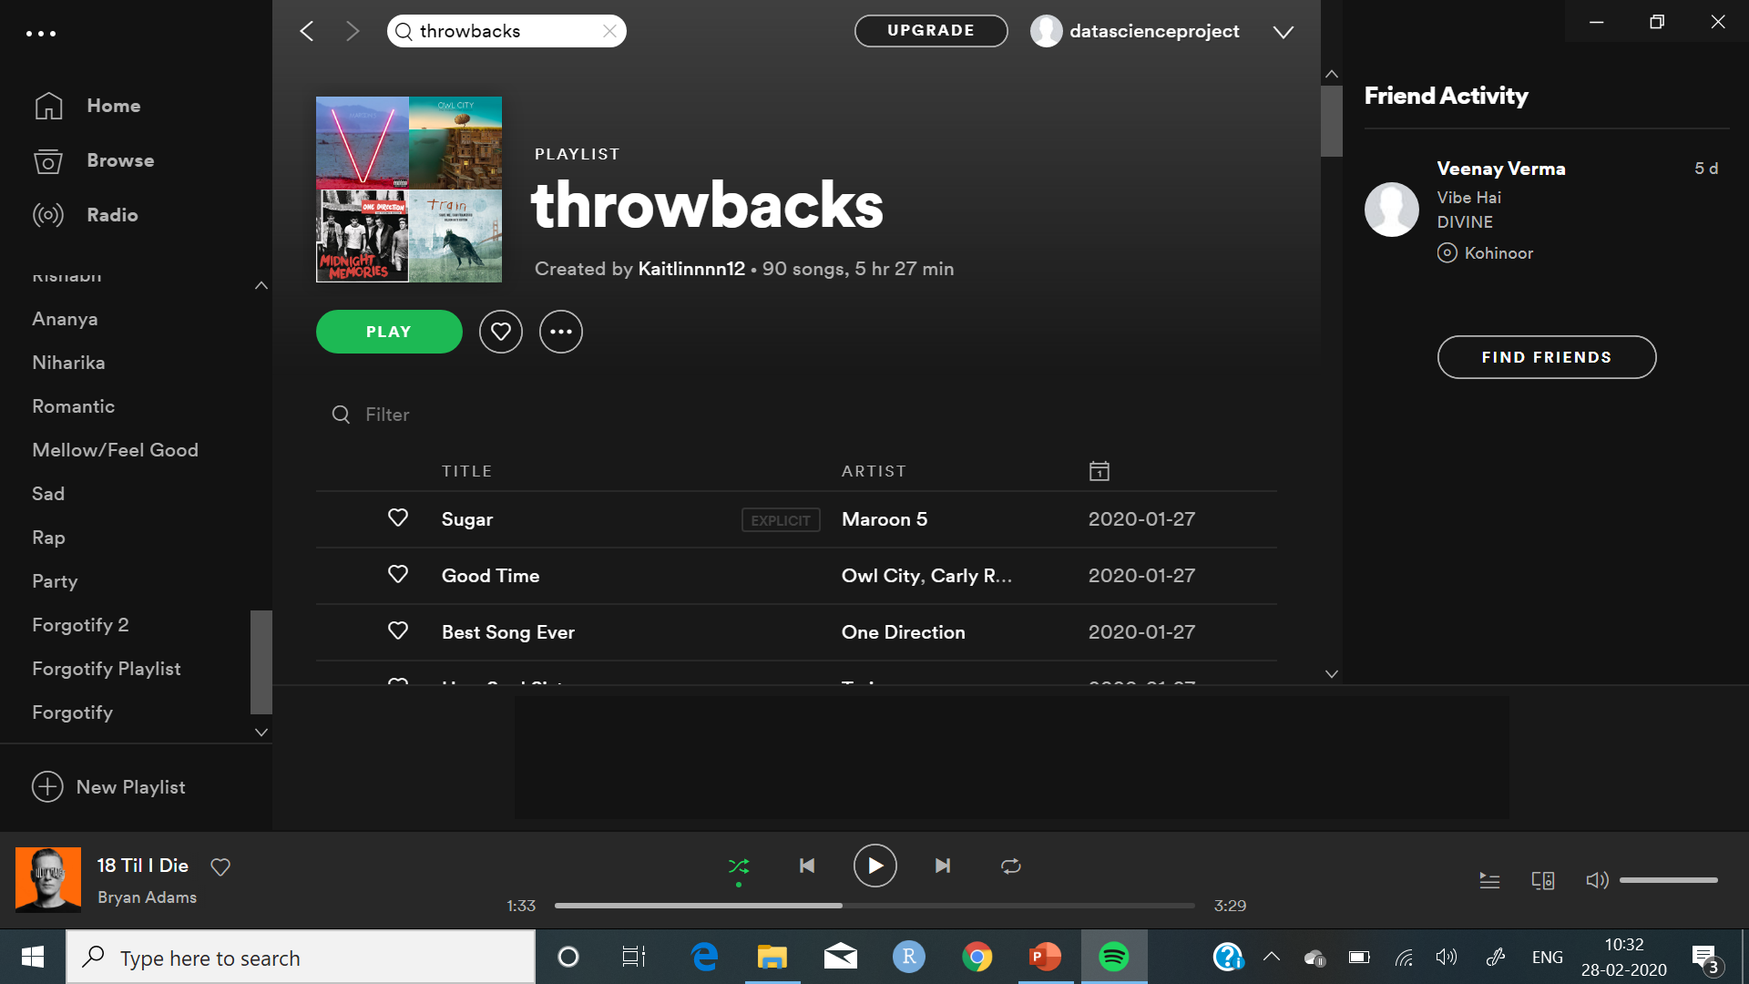
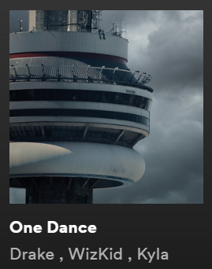

 | S1 | S2 | S3 | S4 | S5 | Dist
P1 | 1 | 0 | 1 | 0 | 0 | 0
P2 | 0 | 0 | 0 | 1 | 0 | 1.73
P3 | 0 | 1 | 1 | 0 | 0 | 1.41
P4 | 1 | 0 | 1 | 1 | 0 | 1
P5 | 0 | 0 | 1 | 0 | 1 | 1.41
Songs from the nearest neighbours that are not in the target playlist are given as recommendations
K-nearest neighbours of the target playlist were found using Euclidean distance

Slide 6








 | P1 | P2 | P3 | P4 | P5 | Dist
S1 | 1 | 0 | 1 | 0 | 0 | 0
S2 | 0 | 0 | 0 | 1 | 0 | 1.73
S3 | 1 | 1 | 1 | 0 | 0 | 1
S4 | 1 | 1 | 0 | 1 | 0 | 1.73
S5 | 0 | 0 | 1 | 0 | 1 | 1.41
For each song in the target playlist, K-nearest songs are found using Euclidean distance
The songs that occur most frequently as neighbours are the final recommendations for the target playlist

Slide 7
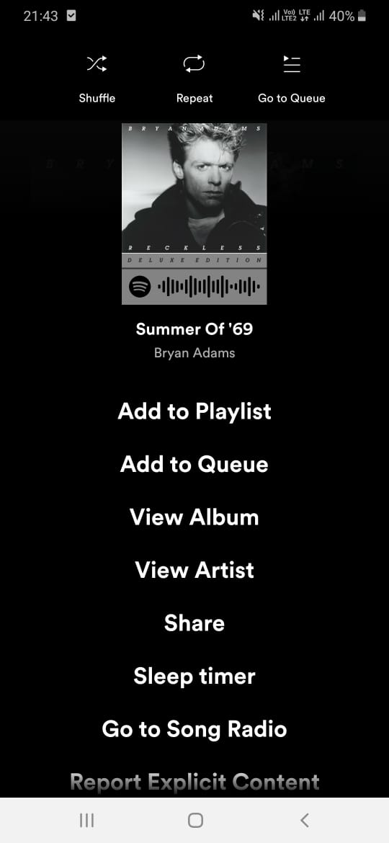
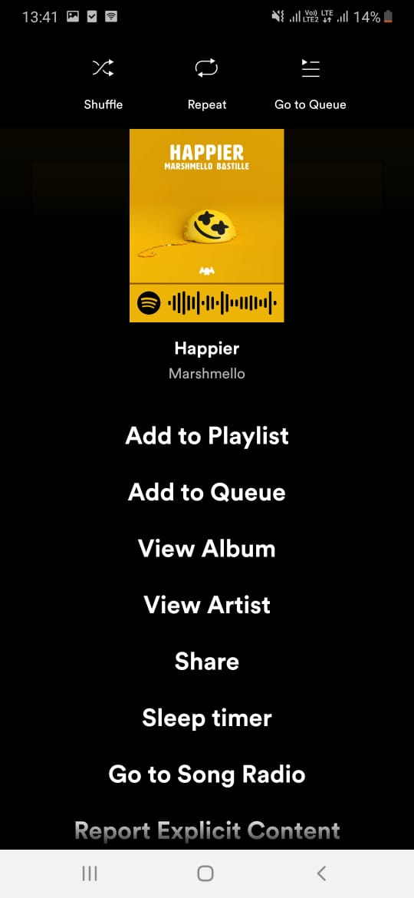
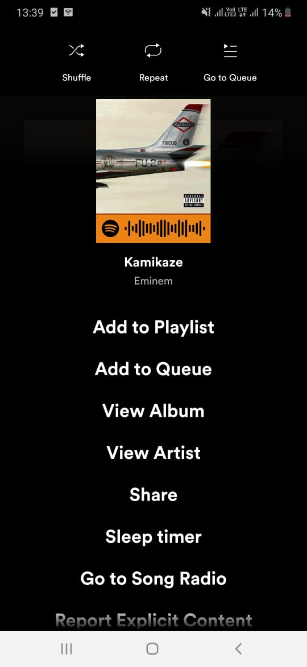
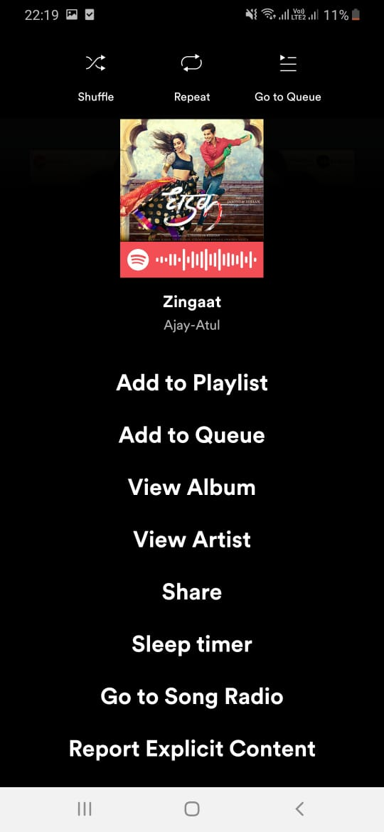
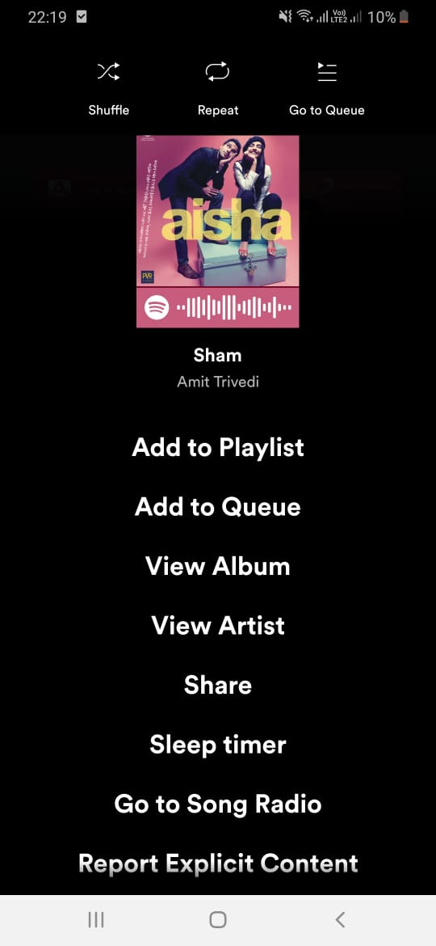
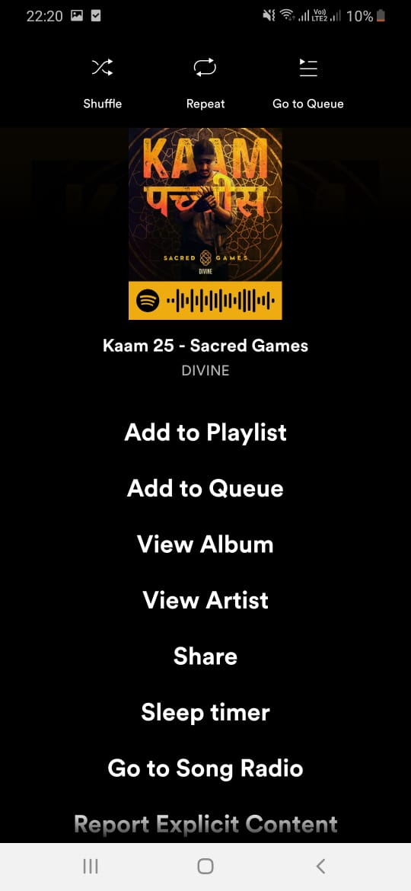

Danceability
Acousticness
Speechiness
Energy
Valence
Loudness
Liveness
Instrumentalness
Tempo

Slide 8
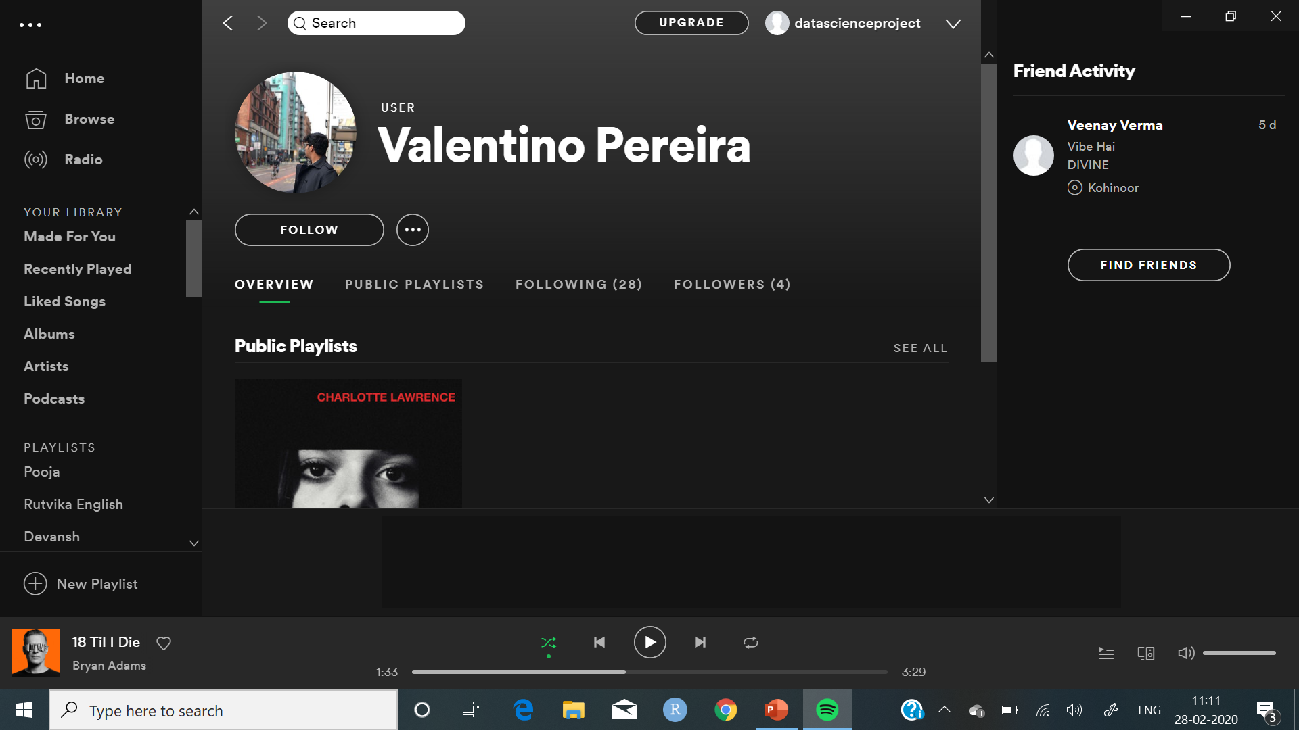
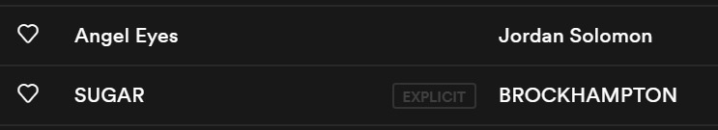
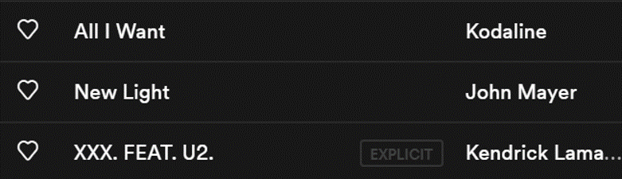
Content Based Filtering
Cosine similarity based on features of the songs is used to find similar songs

Slide 9
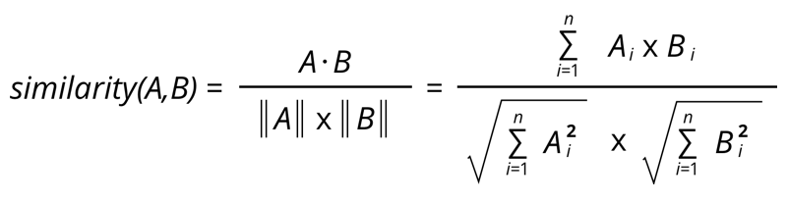
Song\Features | Acousticness | Danceability | Energy | Instrumentalness | Liveness | Loudness | Speechiness | Tempo | Valence
All I Want | 0.172 | 0.209 | 0.412 | 0.150 | 0.084 | -9.733 | 0.044 | 86.260 | 0.162
New Light | 0.325 | 0.828 | 0.689 | 0.038 | 0.081 | -7.878 | 0.033 | 123.931 | 0.853
XXX. | 0.138 | 0.568 | 0.619 | 0.000 | 0.110 | -6.899 | 0.414 | 170.115 | 0.293
Follow Your Fire | 0.009 | 0.453 | 0.61 | 0.000 | 0.175 | -6.583 | 0.067 | 176.079 | 0.440
Angel Eyes | 0.528 | 0.593 | 0.721 | 0.000 | 0.105 | -6.074 | 0.112 | 170.093 | 0.348
SUGAR | 0.449 | 0.453 | 0.538 | 0.000 | 0.190 | -8.212 | 0.064 | 122.973 | 0.516
Roses | 0.342 | 0.782 | 0.5 | 0.000 | 0.133 | -6.473 | 0.061 | 102.001 | 0.281
Lovely | 0.934 | 0.351 | 0.296 | 0.000 | 0.095 | -10.109 | 0.033 | 115.284 | 0.120
Nevermind | 0.159 | 0.6 | 0.688 | 0.000 | 0.409 | -8.339 | 0.201 | 99.977 | 0.079
Ghosts | 0.685 | 0.572 | 0.355 | 0.004 | 0.169 | -7.499 | 0.045 | 138.547 | 0.391
Cosine similarity:
 | Follow Your Fire | Angel Eyes | SUGAR | Roses | Lovely | Nevermind | Ghosts
All I Want | 0.248941 | 0.378643 | 0.581422 | 0.155726 | 0.228722 | 0.114909 | 0.587568
New Light | 0.725421 | 0.826511 | 0.891056 | 0.765036 | 0.418198 | 0.556988 | 0.829941
XXX. | 0.692981 | 0.871031 | 0.820433 | 0.614243 | 0.313207 | 0.568513 | 0.768359

Slide 10
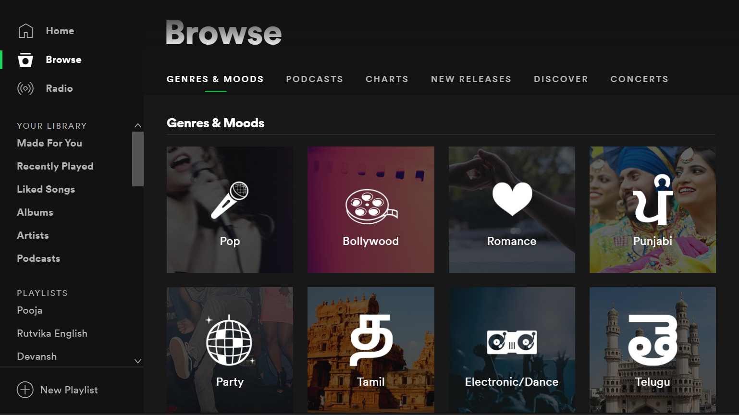




Slide 11



ROCK:
K-Means Clustering
Love Story
Heaven
High energy
and liveness
Zombie
Ride
Humble
POP:
Rap God
Bangerang
21 Guns
One Dance
All We Know
Wonderwall
Perfect
One Dance
Heaven
Cold Water
 | A | D | E | I | L | S | T | V
Cluster 1 | 0.175 | 0.656 | 0.743 | 0.000 | 0.265 | 0.134 | 110.349 | 0.474
Cluster 2 | 0.005 | 0.321 | 0.757 | 0.002 | 0.384 | 0.054 | 177.049 | 0.367
Cluster 3 | 0.038 | 0.605 | 0.672 | 0.001 | 0.186 | 0.053 | 114.643 | 0.385
Cluster 4 | 0.099 | 0.705 | 0.719 | 0.000 | 0.220 | 0.159 | 159.324 | 0.688
Cluster 5 | 0.139 | 0.502 | 0.694 | 0.000 | 0.253 | 0.105 | 98.451 | 0.262
High tempo
 | A | D | E | I | L | S | T | V
Cluster 1 | 0.127 | 0.495 | 0.847 | 0.001 | 0.488 | 0.049 | 124.022 | 0.437
Cluster 2 | 0.064 | 0.438 | 0.594 | 0.000 | 0.270 | 0.124 | 159.086 | 0.332
Cluster 3 | 0.095 | 0.375 | 0.390 | 0.001 | 0.312 | 0.562 | 134.018 | 0.491
Cluster 4 | 0.008 | 0.798 | 0.820 | 0.012 | 0.220 | 0.161 | 147.566 | 0.293
Cluster 5 | 0.221 | 0.642 | 0.716 | 0.001 | 0.103 | 0.046 | 102.972 | 0.576
 | A | D | E | I | L | S | T | V
ROCK | 0.127 | 0.495 | 0.847 | 0.001 | 0.488 | 0.049 | 124.022 | 0.437
POP | 0.064 | 0.438 | 0.594 | 0.000 | 0.270 | 0.124 | 159.086 | 0.332
RAP | 0.095 | 0.375 | 0.390 | 0.000 | 0.312 | 0.562 | 134.018 | 0.491
EDM | 0.008 | 0.798 | 0.820 | 0.012 | 0.220 | 0.161 | 147.566 | 0.293
ROMANTIC | 0.221 | 0.642 | 0.716 | 0.001 | 0.103 | 0.046 | 102.972 | 0.576
 | A | D | E | I | L | S | T | V
Cluster 1 | 0.048 | 0.610 | 0.665 | 0.002 | 0.179 | 0.055 | 145.324 | 0.344
Cluster 2 | 0.067 | 0.574 | 0.730 | 0.001 | 0.311 | 0.130 | 135.631 | 0.562
Cluster 3 | 0.210 | 0.747 | 0.727 | 0.001 | 0.248 | 0.148 | 118.684 | 0.602
Cluster 4 | 0.021 | 0.412 | 0.807 | 0.000 | 0.233 | 0.100 | 139.875 | 0.354
Cluster 5 | 0.110 | 0.446 | 0.656 | 0.000 | 0.337 | 0.072 | 120.302 | 0.316
Love Story
Cold Water
Wonderwall
Toothbrush
Ride
Animals
Humble
RAP:
Zombie
21 Guns
Toothbrush
Rap God
High speechiness
One Dance
Ride
Humble
All We Know
EDM:
Bangerang
High danceability and instrumentalness
Heaven
Animals
The songs are randomly allocated to the clusters and their centroids are found
Wonderwall
The centroids are re-calculated after the updated allocation is done
The clusters are named based on their features
ROMANTIC:
Perfect
High acousticness and valence
Love Story
21 Guns
Animals
All We Know

Slide 12
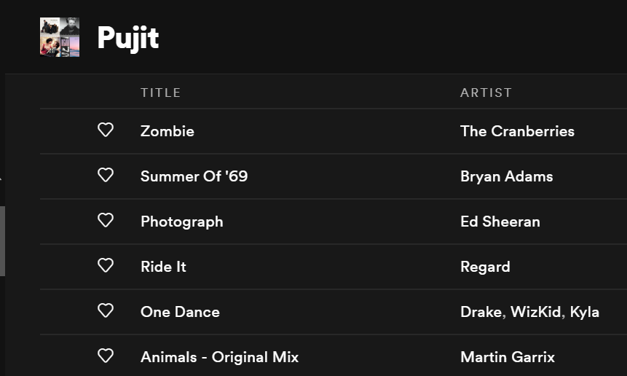
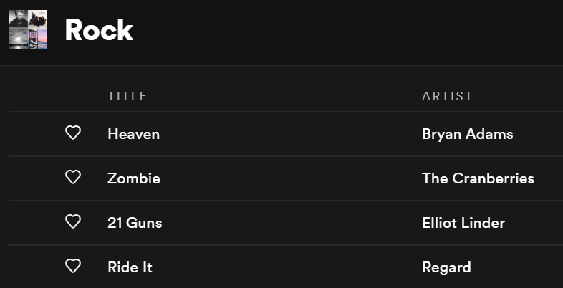

ROCK:
K-Means Clustering
Heaven
Zombie
21 Guns
POP:
Ride
Wonderwall
Cold Water
Toothbrush
Zombie
RAP:
Rap God
One Dance
Humble
Ride
Green Day
EDM:
One Dance
Bangerang
Animals
Animals
ROMANTIC:
Perfect
Love Story
All We Know

Slide 13
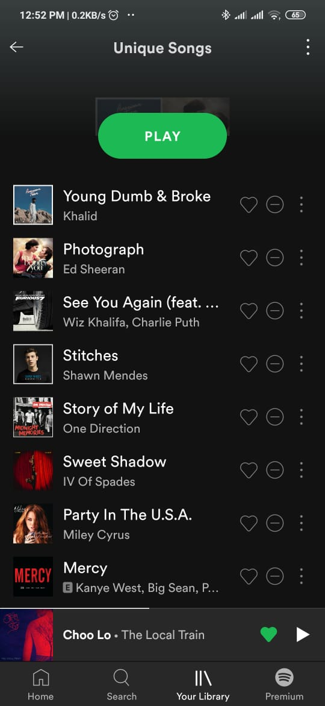
Word to Vector Model
We first create a list of all unique songs in the dataset.
Then we find the one hot representation of our dataset.
Unique Songs
One Hot Representation
1 | 0 | 0 | 0 | 0 | 0 | 0
0 | 1 | 0 | 0 | 0 | 0 | 0
0 | 0 | 1 | 0 | 0 | 0 | 0
0 | 0 | 0 | 1 | 0 | 0 | 0
0 | 0 | 0 | 0 | 1 | 0 | 0
0 | 0 | 0 | 0 | 0 | 1 | 0
0 | 0 | 0 | 0 | 0 | 0 | 1

Slide 14
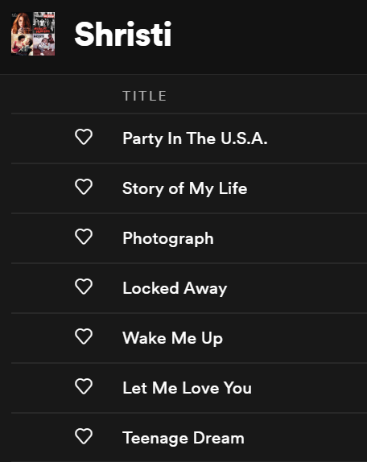





Word To Vector Model

Slide 15
Word to Vector Model
Hidden layer
(1 X h)
Output layer
(1 X n)
Input layer
(1 X n)
Weight 1
(n X h)
Weight 2
(h X n)
Y-pred | Story of My Life | Difference
0.218 | 0 | 0.218
0.016 | 0 | 0.016
.010 | 0 | 0.010
0.205 | 0 | 0.205
0.107 | 1 | -0.893
0.189 | 0 | 0.189
0.006 | 0 | 0.006
Y-pred | Photo-graph | Difference
0.218 | 0 | 0.218
0.016 | 1 | -0.984
.010 | 0 | 0.010
0.205 | 0 | 0.205
0.107 | 0 | 0.107
0.189 | 0 | 0.189
0.006 | 0 | 0.006
Error
0.436
-0.968
0.02
0.41
-0.786
0.378
0.012

Slide 16
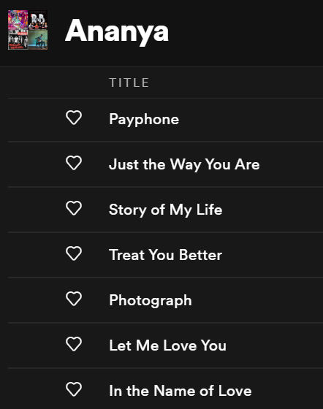


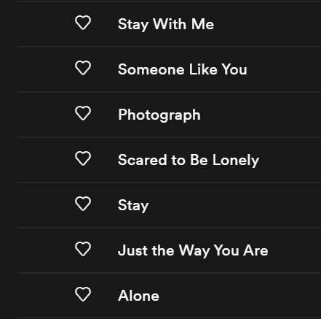
Word to Vector Model
Just the Way You Are
Story of My Life
Story of My Life
Photograph
Photograph
Photograph
Let Me Love You
Just the Way You Are
Let Me Love You
[0.487 | 0.796 | … | 0.204 | 0.683]
[0.736 | 0.585 | … | 0.386 | 0.972]
[0.563 | 0.722 | … | 0.198 | 0.659]

Slide 17
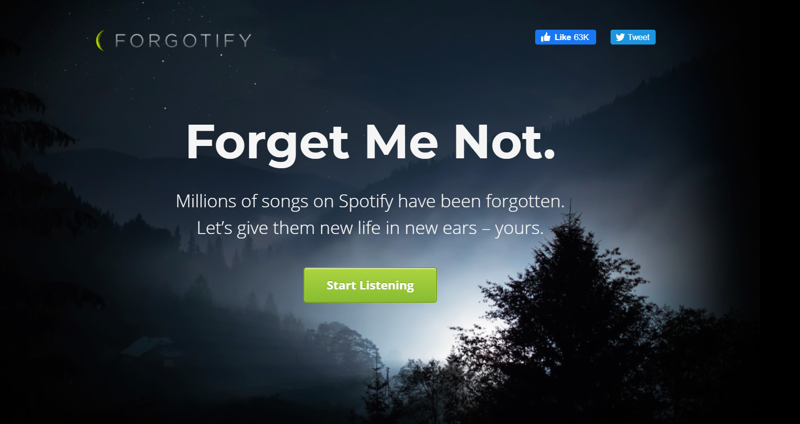

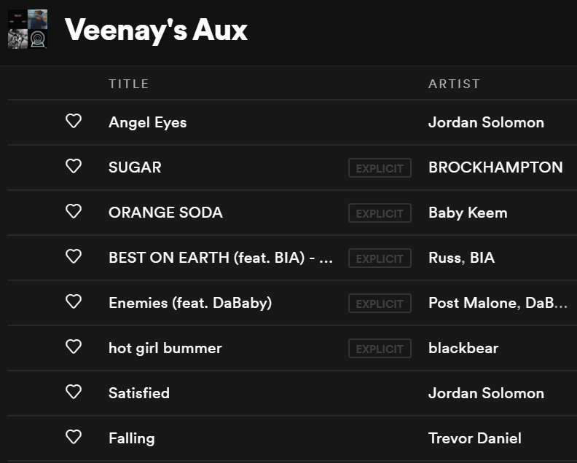
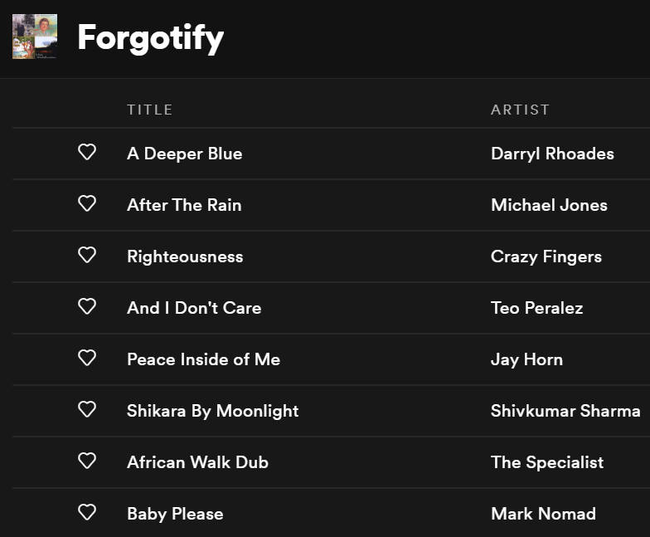
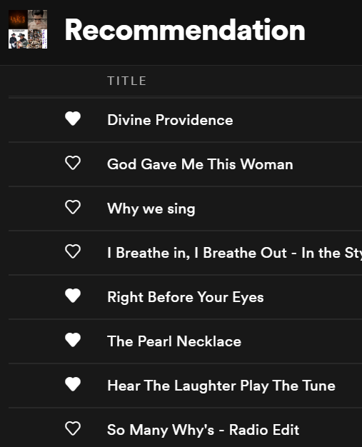
Using content-based filtering, we aim to make these forgotten songs remembered by recommending these to users.

Slide 18
LIMITATIONS
The accuracy of the recommendations cannot be checked due to their subjective nature.
The order of songs in a playlist may not be the same as the order in which they are played. This may affect the recommendations made through NLP.
In collaborative filtering songs not in the user playlists cannot be recommended, while in clustering, songs by artists not in your playlist will not be recommended.

Slide 19




THANK YOU
PUJIT GOLCHHA
A005
SHRISTI JAIN
A012
ANANYA KAMDAR
A014
PHALGUNI KOTHARI
A017

